Slide 1
Possessive exercises
Basic 1 Unit 1 a

Slide 2
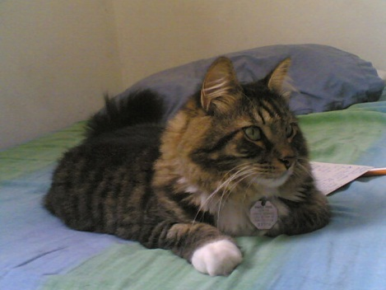
My / I´m pen is red.
His / He´s name is Jorge
Lucia is her / she´s friend.
Her / she´s favorite TV Show is C.S.I.
Its / it´s a book.
Its / it´s name is Koshka.
Your / you´re name is Kiki.
This is your / you´re textbook.

Slide 3
My / it´s pen is red.
Her / his name is Jorge
Lucia is her / she´s friend.
Her / it´s favorite TV Show is C.S.I.
My / it´s a book.
Its / his name is Koshka.
Your / you´re name is Kiki.
This is your / youre textbook.

